Slide 1



CNN Model for American Sign
Language Recognition
Authors : Tilottama Goswami and Shashidhar Reddy Javaji
Presenter :
Pathik Prashant Ghugare, 1911014

Slide 2

What this paper is all about?
Notes:
This paper proposes a model based on convolutional neural network for
hand gesture recognition and classification.
Deep learning technique is used based on CNN which automatically
learns and extracts features for classifying each gesture. The paper does comparative
study with four recent works. The proposed model reports 99% test accuracy.
Nearly 5% of the world’s population is said to be hearing impaired, this creates a
major problem for the communication with the deaf and the dumb, specially abled
persons. To decrease the communication gap between hearing impaired community
and the normal persons, ideas have evolved over the years based on technology.
machine learning and its application has been increasing rapidly in the present
decade. Convolutional Neural Networks (CNN) is popularly used to train machines
to recognize and classify image

Slide 3
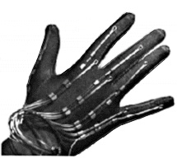
Glove
First work was started by the MIT in the year 1977 called the Sayre glove
All these works were purely based on sensors and mostly come under Human Computer Interaction (HCI) systems
This Photo by Unknown author is licensed under CC BY-NC-ND.
Notes:
Human Computer Interaction Using Hand Gestures, refrences Premaratne P

Slide 4
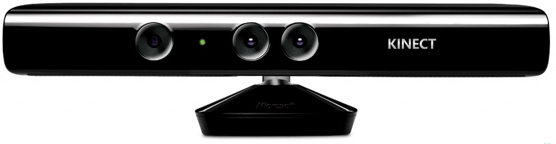
Microsoft Kinect
Kinect (codenamed Project Natal during development) is a line of motion sensing input devices produced by Microsoft and first released in 2010.
This Photo by Unknown author is licensed under CC BY-SA-NC.
Notes:
American sign language alphabet recognition using Microsoft Kinect related works , references Dong C (2015) The technology includes a set of hardware originally developed by PrimeSense, incorporating RGB cameras, infrared projectors and detectors that mapped depth through either structured light or time of flight calculations, and a microphone array, along with software and artificial intelligence from Microsoft to allow the device to perform real-time gesture recognition, speech recognition and body skeletal detection for up to four people, among other capabilities

Slide 5
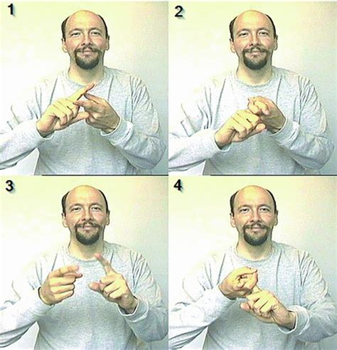
Video-Based
'The Video-based sign language recognition without temporal segmentation' has used Latent space hierarchical attention network (LSHAN)
which is an advancement of Long Short Term Memory (LSTM). It has been used for video-based sign recognition for German Sign Language and CSL for classification.
Notes:
Huang J, Zhou W, Zhang Q, Li H, Li W (2018)

Slide 6
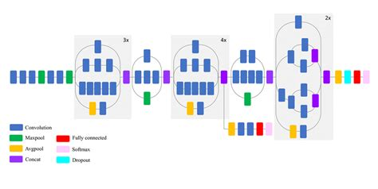
Convolutional Neural Network
Inception V3
Notes:
Inception v3 [9], is
another version of image classification which is similar to CNN but instead of
layers like convolutional, pooling and softmax being on top of one another, the
layers are made to run parallel to one another. Principal Component Analysis has
been used for recognition of the images.

Slide 7
Proposed Methodology

Slide 8
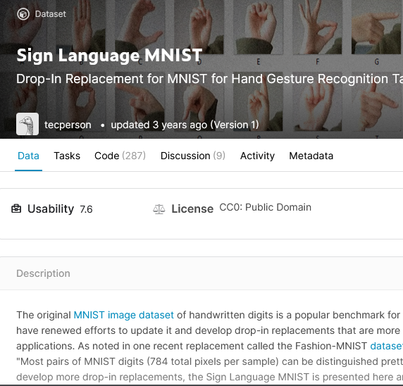
1. Dataset
The dataset is patterned to match with the classic MNIST. Each training and test case represents a label (0–25) as a one to-one map for each alphabetic letter A–Z (and no cases for J = 9 or Z = 25 because of gesture motions).

Slide 9

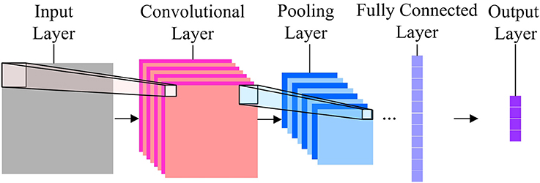
2. CNN
Notes:
Just like a usual Neural Network , it is also a Neural network but with some functionalities of feature extraction

Slide 10
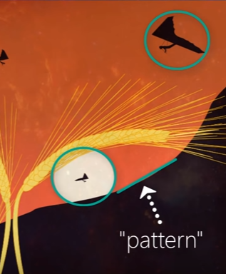
CONVOLUTIONAL LAYER ?
They Look for the patterns !

Slide 11
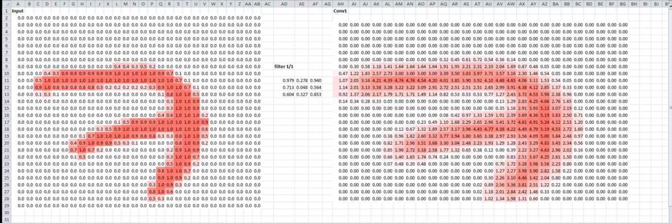
Filters

Slide 12
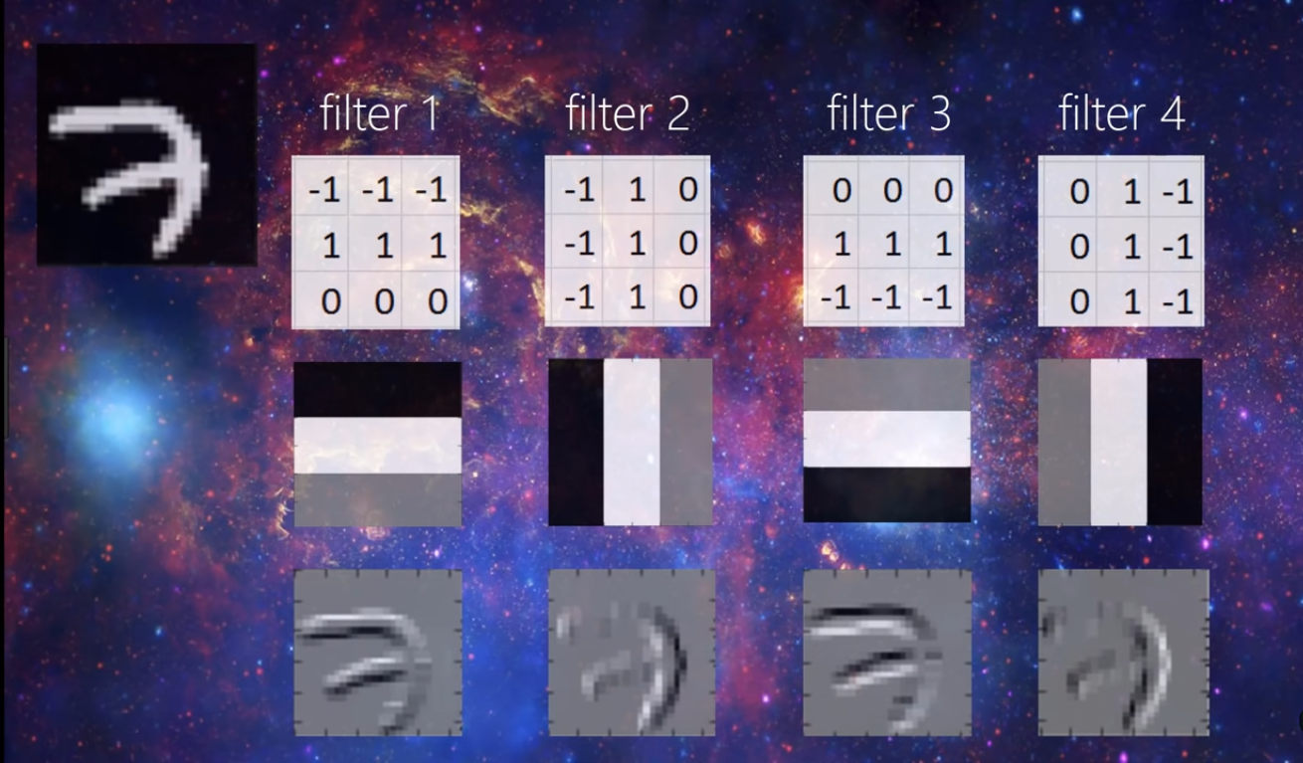

Slide 13
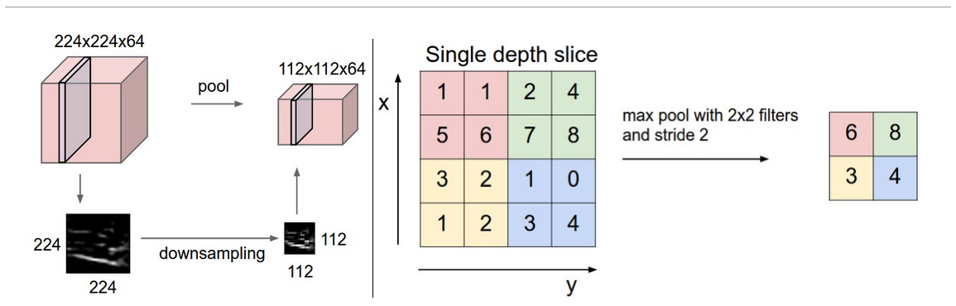
CNN model
CNN model with 4 convolutional layers having 32,32,64,128 filters of size 3x3 in respective layer with Max Pooling layer
Notes:
Convolutional Neural Networks is chosen as the deep learning methodology for
the development of this model. Four convolutional layers are added to this model
along with Max pooling layer.

Slide 14
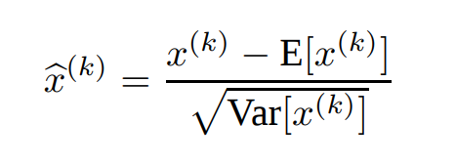
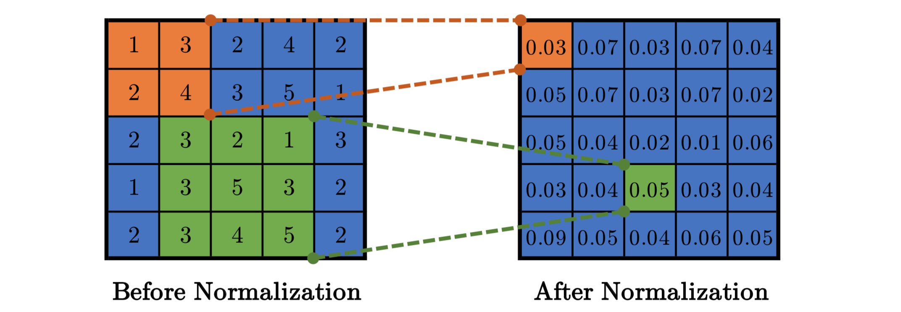
Batch Normalization
Each CNN layer is going through Batch Normalization

Slide 15
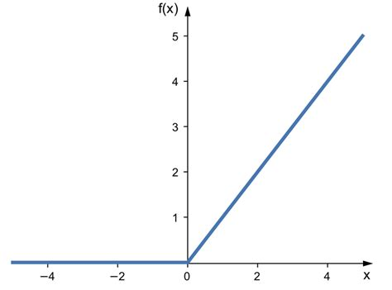
ReLU function

Slide 16
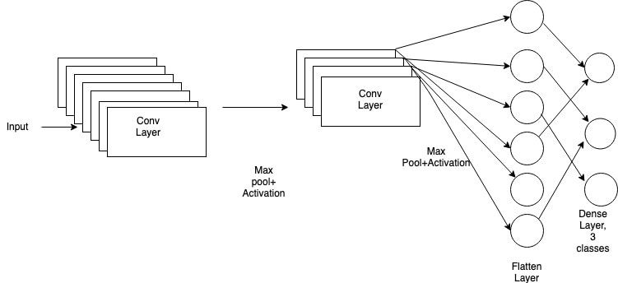
Dense or fully connected layers
Dense Layer with 128 neurons
Final Layer which has 24 neurons and it is followed by softmax activation function

Slide 17
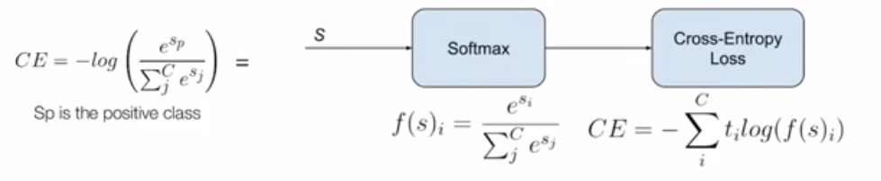
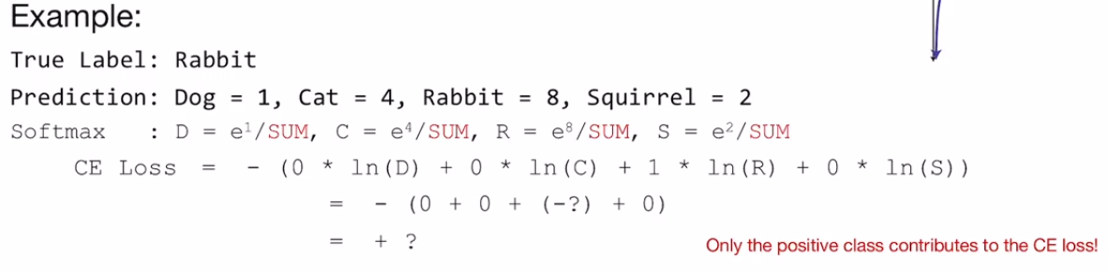
Model Compilation
Categorical Cross Entropy Loss Function or Softmax loss

Slide 18
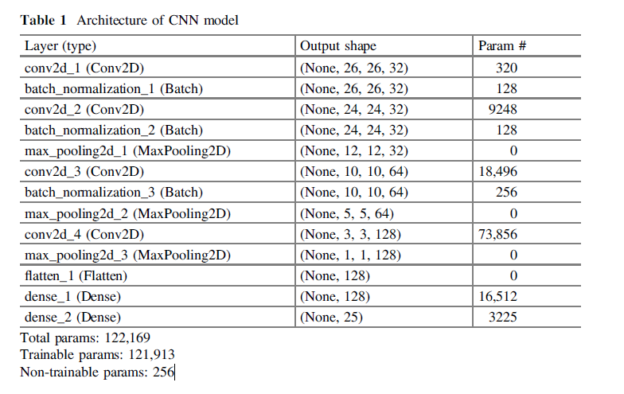
Architecture of CNN model

Slide 19
Regularization Function
history=conv.fit_generator( batches,steps_per_epoch=21964//128, epochs=30,validation_data=val_batches,validation_steps=5491//128, use_multiprocessing=True)

Slide 20
Training
Activation Function: ‘Relu’,
Number of convolutional layers: 4,
Epochs: 30,
Batch Size:256,
Regularization function,
Test Accuracy:99.3%.

Slide 21
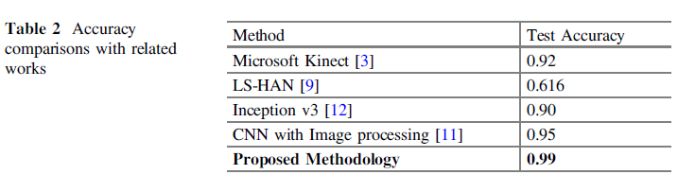
Results

Slide 22
Result Analysis
Initially accuracy was 94 % for final layer filters = 128, epoch = 10 , but it went to 97 % after making final layer filters = 256, epoch = 50
Initially they were using Sigmoid Activation functions instead of Relu which decreased the value of accuracy of the model. Relu proved to be better activation function than sigmoid
When epochs were increased to 70 the accuracy has gone down to 95%, the main reason being over fitting
At last by using regularization, after normal training of the model, achieved a test accuracy of 99%, which shows that regularization helps in increasing the accuracy in this model after normal training of the model.

Slide 23
Conclusion
The paper contributes a improved CNN model which has given better accuracy in gesture recognition based on American Sign Language
The authors have compared with 4 previous works and found the proposed methodology produces best accuracy.
In future, the work can be taken to next dimension to be more interactive by capturing the live video and display the results on the screen, thereafter convert to speech

Slide 24
References
Premaratne P (2014) Human Computer Interaction Using Hand Gestures, vol XV, pp 158–174. ISBN 978-981-4585-68-2
Dong C (2015) American sign language alphabet recognition using Microsoft Kinect. Masters Thesis, 7392. https://scholarsmine.mst.edu/masters_theses/7392
Huang J, Zhou W, Zhang Q, Li H, Li W (2018) Video-based sign language recognition without temporal segmentation. In: 32nd AAAI Conference on Artificial Intelligence (AAAI-2018), New Orleans, Louisiana, USA, 2–7 February 2018. arXiv:1801.10111
Nagi J., Ducatelle F, Di Caro GA, Cireşan D, Meier U, Giusti A, Nagi F, Schmidhuber J,Gambardella LM (2011) Max-pooling convolutional neural networks for vision-based handgesture recognition. In: 2011 IEEE International Conference on Signal and Image Processing Applications (ICSIPA2011), Malaysia, 16–18 November 2011. ISBN 978-1-4577-0242-6

Slide 25
Strategy for implementation
Sign Language MNIST data from kaggle which contains 27k images of size 28*28
Preprocessing with numpy, cv2
For model creation, python libraries such as tensorflow, keras

Slide 26
Thank you !

